Slide 1
Introduction to MAD-X
N. Fuster Martínez, IFIC (CSIC-UV)
Material based on Guido Sterbini, Öznur Mete and Bruce Yee courses
22nd of January 2024

Slide 2

DISCLAIMER
GOAL
The goal of this course and workshop is to work on the understanding of transverse beam dynamics concepts by taking a hands-on approach (using the software MAD-X), and gain design and operational experience
This material is intended to be a very brief introduction to MAD-X: a large part of the code capabilities are not discussed in detail or are not discussed at all!
If you want to deepen into the subject, you can find a lot of material in:
The official MAD-X web site: http://mad.web.cern.ch/mad/
An Introduction to Beam Physics: https://library.oapen.org/bitstream/handle/20.500.12657/50888/9781420011821.pdf?sequence=10

Slide 3
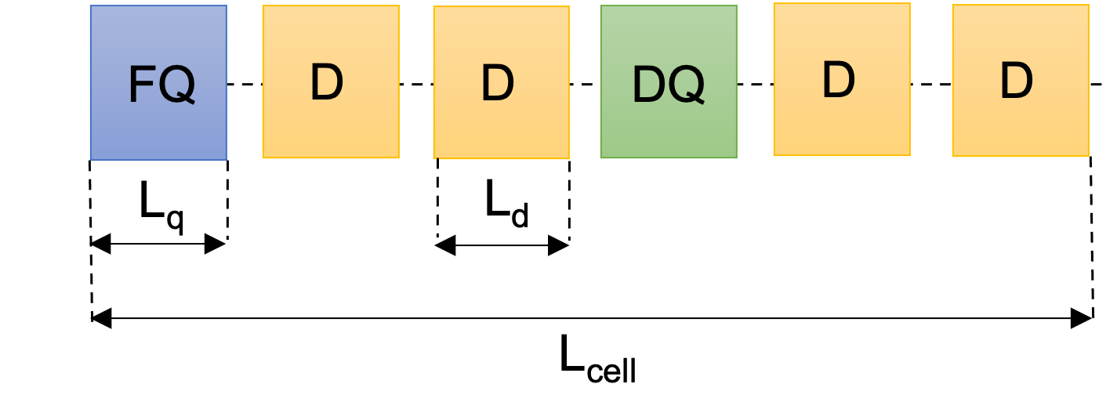
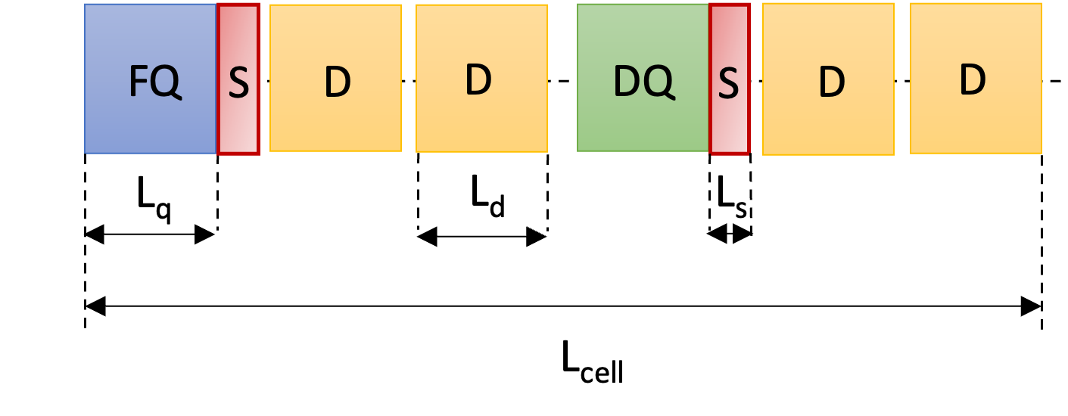
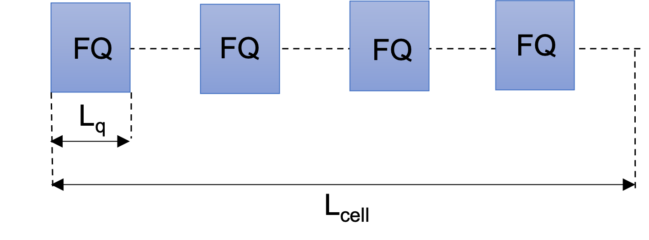
MAD-X workshop overview
50 minutes lecture (now!)
First “hands-on” session (3h) (22nd afternoon)
Tutorial 1: My first accelerator, a FODO cell
Tutorial 2: My first matching
30 minutes break
Tutorial 3: Building a circular machine
Second “hands-on” session (3h) (23rd afternoon)
Tutorial 4: Natural chromaticity
Tutorial 5: Chromaticity correction and non-linearities
30 minutes break
Tutorial 6: Building a transfer line
Tutors: Nuria Fuster-Martínez, Guido Sterbini, Davide Gamba, Sofia Kostoglou, Javier Olivares

Slide 4
Outline
Introduction. Description of basic concepts
MAD-X language. Syntax, variables
MAD-X commands. Magnets, sequence and beam definition
Advanced MAD-X commands. Twiss, matching and tracking
Example case. A FODO cell
How to run MAD-X. Interactive mode, batch mode and python interface

Slide 5
Introduction
General purpose of a beam optics code
What is MAD-X?
Do we use MAD-X for everything? No!
Why MAD-X?
How does it work?
Source code: the basic components

Slide 6

General purpose beam optics code
A comprehensive modelling on how charged particles interact with external EM fields (from different accelerators components) is the foundation behind general purpose beam optics codes
They enable us to design accelerators (GUIDE, FOCUS AND PRESERVE) meeting specific research and application goals and to predict the behaviour of particle beams in those accelerators with a high degree of accuracy
Simulation by Stephen Brooks (Brookhaven National Laboratory)

Slide 7
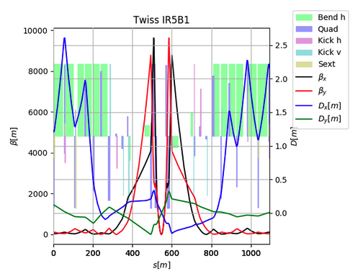
General purpose beam optics code
They are used to:
Define the lattice of circular or linear accelerators
Compute linear optics functions and beam properties
Design a lattice for getting the desired properties (matching)
Simulate accelerator imperfections and design correction schemes
Simulate different operation modes of a machine
Simulate beam dynamics: study single-particle motion
LHC IP5

Slide 8
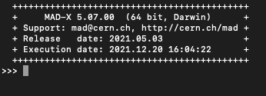

What is MAD-X?
MAD-X (Methodical accelerator Design)
A general-purpose beam optics software
Distributed for free by CERN and used since more than 25 years for machine design and simulations (PS, SPS, LHC, linacs…)
MAD-X is written in C/C++/Fortran (source code available under the CERN copyright)

Slide 9

Do we use MAD-X for everything? No!
We use MAD-X to:
Perform basic layout design and optimization
Perform basic single-particle tracking and sensitivity analysis of linear and circular accelerators
We don’t use MAD-X for:
Multi-particle and multi-bunch simulations
Simulations requiring non static machines, i.e., beam changes its own environment (space charge, instabilities, beam-beam effects)
Often the programs used for these kind of studies use inputs from MAD-X

Slide 10
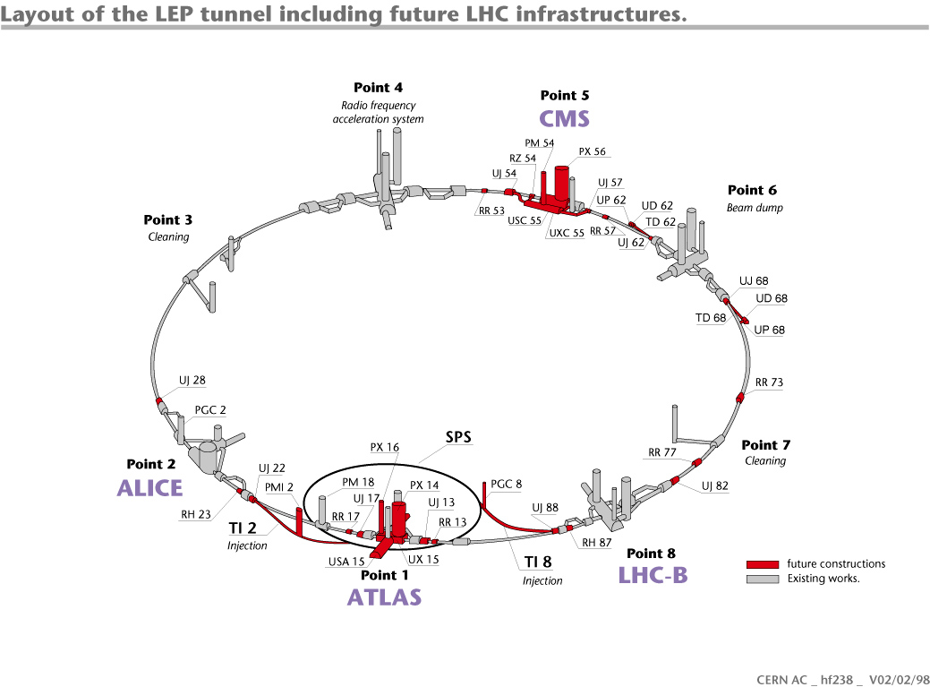
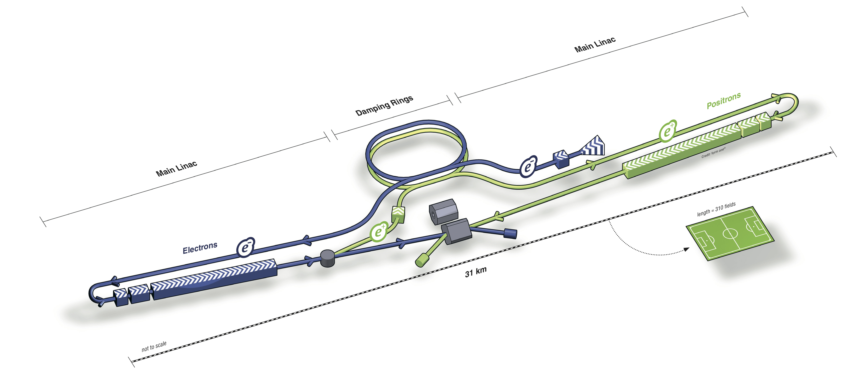
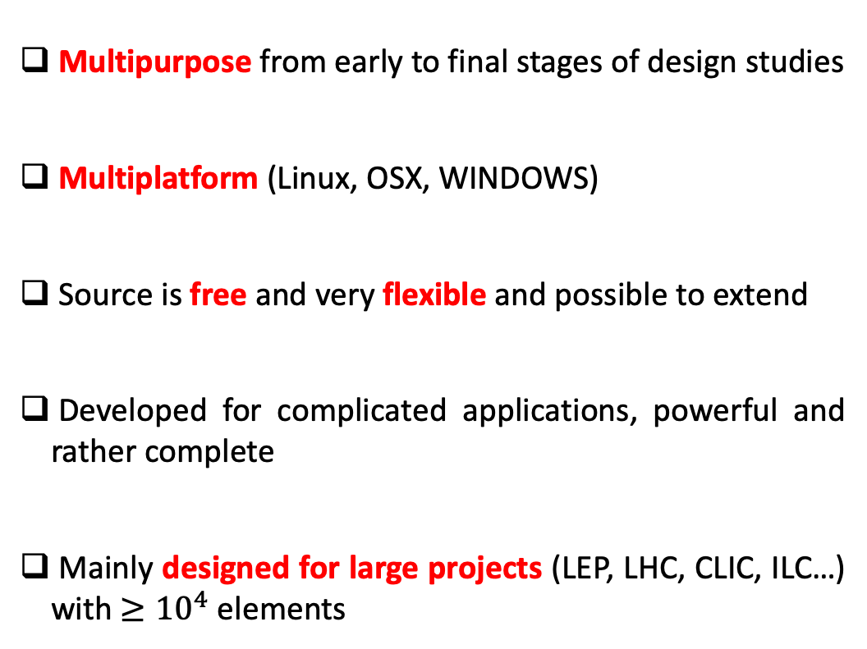
Why MAD-X?
Multipurpose from early to final stages of design studies
Multiplatform (Linux, OSX, WINDOWS)
Source is free and very flexible and possible to extend
Developed for complicated applications, powerful and rather complete
Mainly designed for large projects (LEP, LHC, CLIC, ILC…) with $≥{10}^{4}$ elements

Slide 11
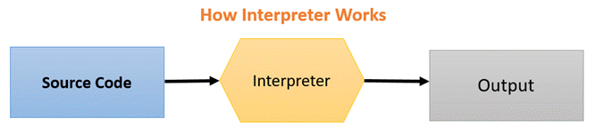
How does it work?
MAD-X is an interpreter
It accepts and executes statements
Statements can be actions (optics…) or assignments (machine properties…)
What is the source code? Via text
It can be used in an interactive way (input from command line) or in batch (input from a file)
MAD-X has its own scripting language, which is used to interface with the software
Strong resemblance to “C” language (but NO need for declaration and NOT case sensitive)
Many features of programming language (loops, if, macros…)

Slide 12
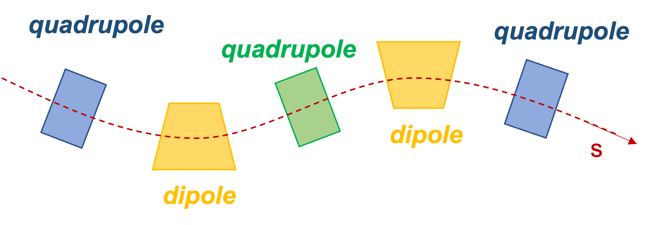

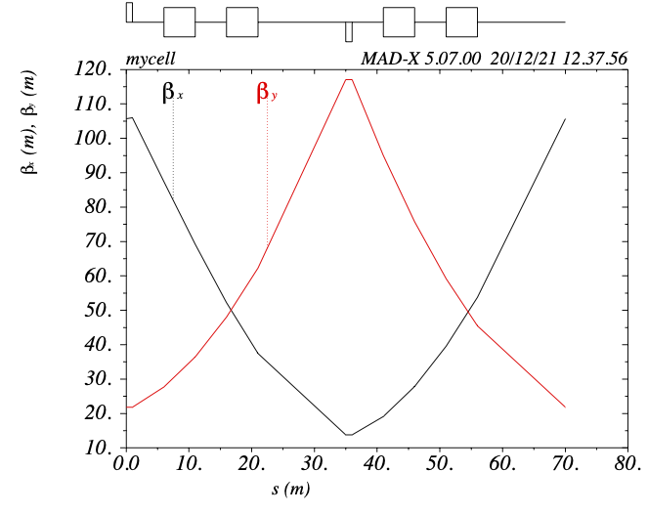
Source code: the basic components
Description of the machine
Accelerator elements, physical attributes and location….
What is the machine in question?
Description of the beam
Type of particle, energy…
What will be running in the machine?
Actions
Optics calculation, matching, tracking….
What do you want to study about the machine?

Slide 13
MAD-X language
Language features
Conventions
Optic variables

Slide 14

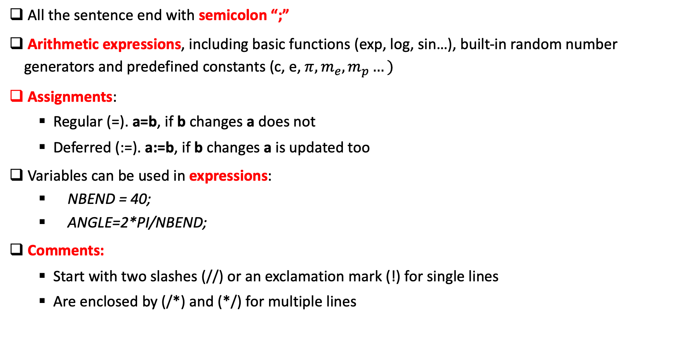
Language features
All the sentence end with semicolon “;”
Arithmetic expressions, including basic functions (exp, log, sin…), built-in random number generators and predefined constants (c, e, $π, m_{e},m_{p}…)$
Assignments:
Regular (=). a=b, if b changes a does not
Deferred (:=). a:=b, if b changes a is updated too
Variables can be used in expressions:
NBEND = 40;
ANGLE=2*PI/NBEND;
Comments:
Start with two slashes (//) or an exclamation mark (!) for single lines
Are enclosed by (/*) and (*/) for multiple lines
Deferred expressions Important for the variables you may need to change along the code (e.g. matching parameters…)!

Slide 15
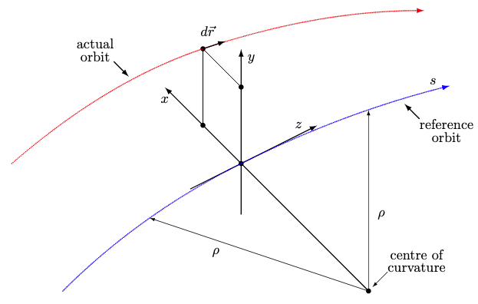
Conventions
Units: all parameters are in terms of SI units, except the energy, momentum and mass expressed in GeV, GeV/c and GeV/c²
The horizontal plane is assumed to be the bending plane
Elements are placed along the reference orbit moving along s
x = y = 0 in a curvilinear system
The reference orbit is the path of a charge particle having the central momentum of the accelerator though idealised and perfectly aligned magnets
The closed orbit is described with respect to the reference orbit, using the local reference system (x, y, s) and includes all nonlinear effects

Slide 16
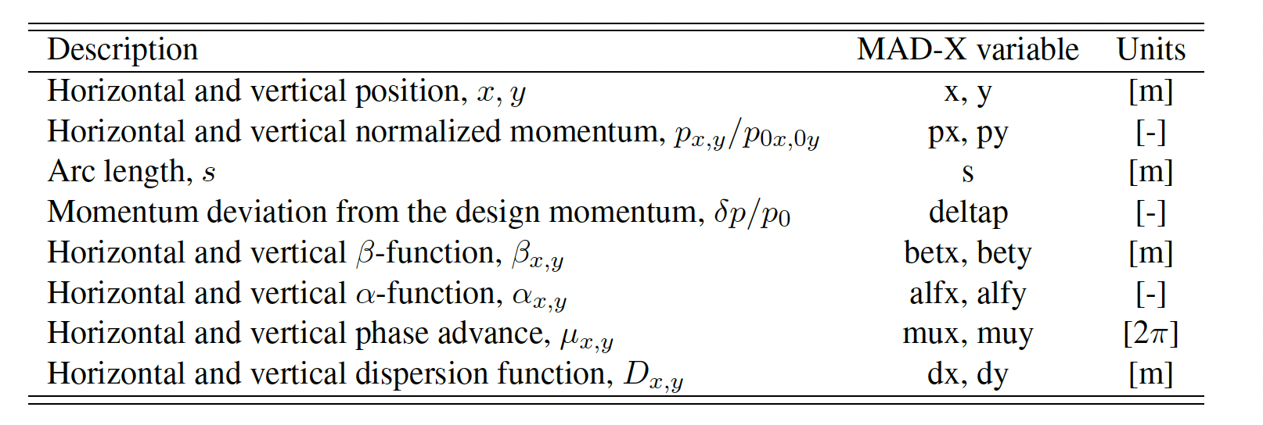
Main particle’s coordinates and optics functions

Slide 17
MAD-X commands
Generic pattern for MAD-X commands
Definition of lattice elements
The strength of the magnets
The lattice sequence
Basic MAD-X commands

Slide 18
Generic pattern for MAD-X commands
label: keyword, {attributes};
Name given by the USER to the stored command.
If a label is given, MAD-X keeps this command in memory and can be used as
‘EXEC label;’
Action desired.
Protected by MAD-X, cannot be used as label
Defined data to the command.
String, logical, integer, expression or range selection. The items enclosed in {} can be omitted

Slide 19
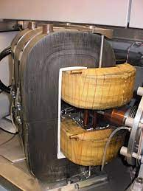
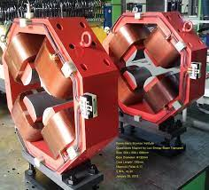
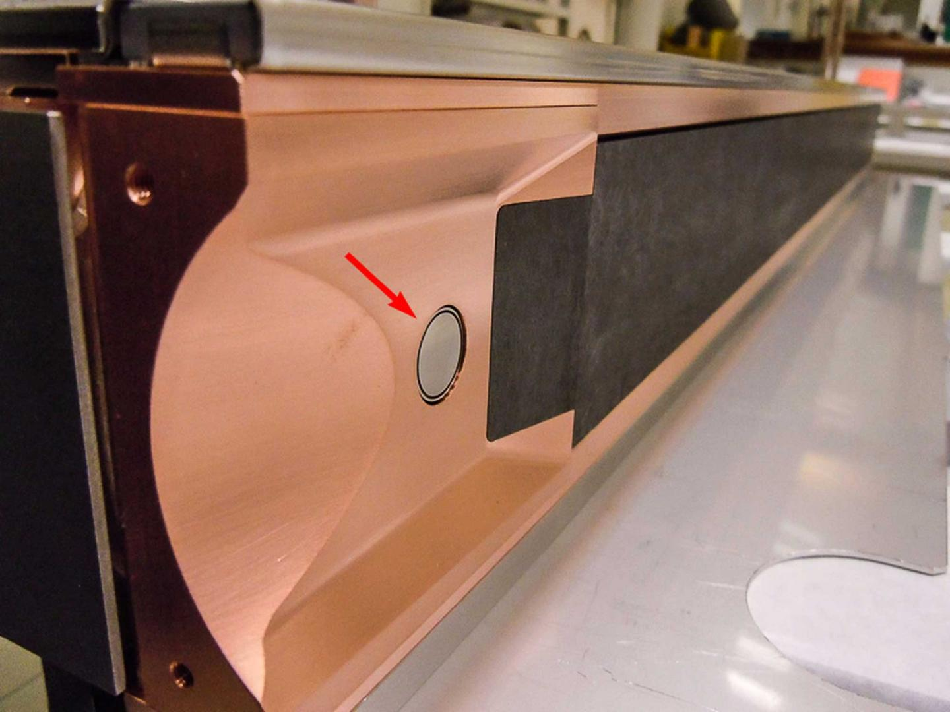
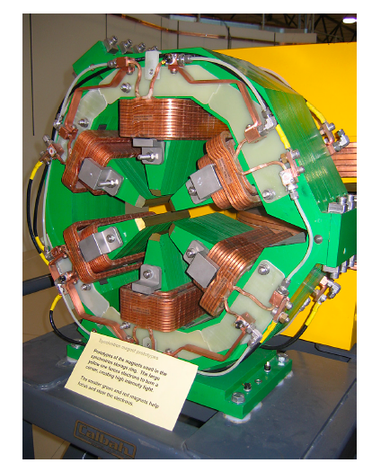
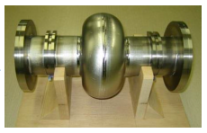
Definition of lattice elements
Each machine element or group of elements must be defined by a command
Generic pattern to define an element
label: keyword, properties;
MAD-X keywords are used to define the type of element:
magnets, markers, RF cavities, collimators…
Examples:
Dipole magnet: MBL: SBEND, L=10.0;
Quadrupole magnet: MQ: QUADRUPOLE, L=3.3;
Sextupole magnet: MSF: SEXTUPOLE, L=1.0;
Marker: MARKER1: MARKER;

Slide 20
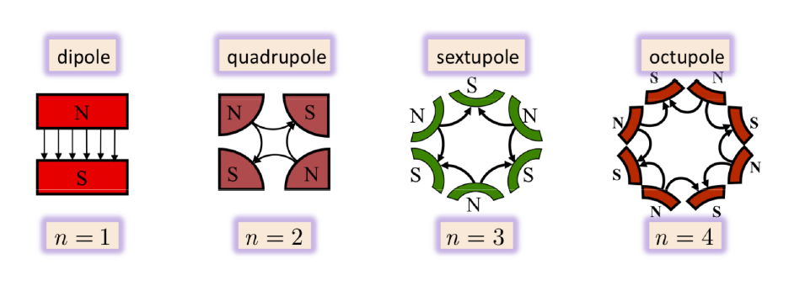

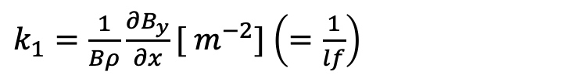
The strength of the magnets
The magnetic strength is a key parameter on the magnetic lattice beam dynamics design
The name defining the magnetic strength depends on the element:
For a dipole magnet (horizontal bending) is : angle [rad]
MBL: SBEND, ANGLE=0.05, L=10.0;
$k_{1}=\frac{1}{Bρ}\frac{∂B_{y}}{∂x}[ m^{−2}]$ $\left(=\frac{1}{lf}\right)$
For a quadrupole magnet is :
MQ: QUADRUPOLE, K1=0.00156, L=3.3;
$$k_{2}=\frac{1}{Bρ}\frac{∂^{2}B_{y}}{∂x^{2}}[m^{−3}]$$
For a sextupole magnet is:
ksf= 0.00015;
MSF: SEXTUPOLE, K2=ksf, L=1.0;
Octupoles, multiple magnet “thin” element…

Slide 21
The lattice sequence
Is an ordered collection of machine elements defining the accelerator to be studied
The position of each element in the sequence can be defined with respect to the CENTRE, EXIT or ENTRY of the element, the start of the sequence or the position of another element
Example:
#Element definition
MQ: QUADRUPOLE, L=3.3, K1=0.005;
# Sequence definition
mycell: SEQUENCE, REFER=ENTRY, L=10;
q1: MQ, at s=0;
marker1: marker, at s=2.5 , from=q1;
ENDSEQUENCE;
The USE command expands the specific sequence, inserts drift spaces between elements and activate the sequence to make it usable for other operations:
USE, SEQUENCE=name_sequence;

Slide 22
Basic useful MAD-X commands
Beam definition:
BEAM, PARTICLE=particle_type (proton, electron…), ENERGY=value ;
Call an external file:
CALL, FILE=name_file.madx;
Print a value in the terminal:
VALUE variable_name;
Production of graphical output (e.g. β-function)*:
PLOT, HAXIS=s, VAXIS=betx,bety, COLOUR=100, FILE=“test” ;
* Note that the data must be generated first using the advances commands such as TWISS or TRACK.

Slide 23

Questions on this first part?

Slide 24
Advances MAD-X commands
TWISS*. Optics calculations
MATCHING*. Optics optimization
TRACKING*. Beam dynamics studies
*These commands require a beam and an active sequence

Slide 25
TWISS
The TWISS command will compute the linear lattice function (optical functions and the CO) around the machine and optionally the chromatic functions
This module is based on a matrix multiplications formalism using first and second order matrices
Example:
# For a periodic solution
TWISS, SEQUENCE=sequence_label, exit(by default), FILE=“test.txt”, table=TWISS (by default);
# For an initial condition (IC) solution
TWISS, SEQUENCE=sequence_label, betx=1, alfx=0, bety=1, alfy=0;
# More attributes: DELTAP, CHROM…

Slide 26
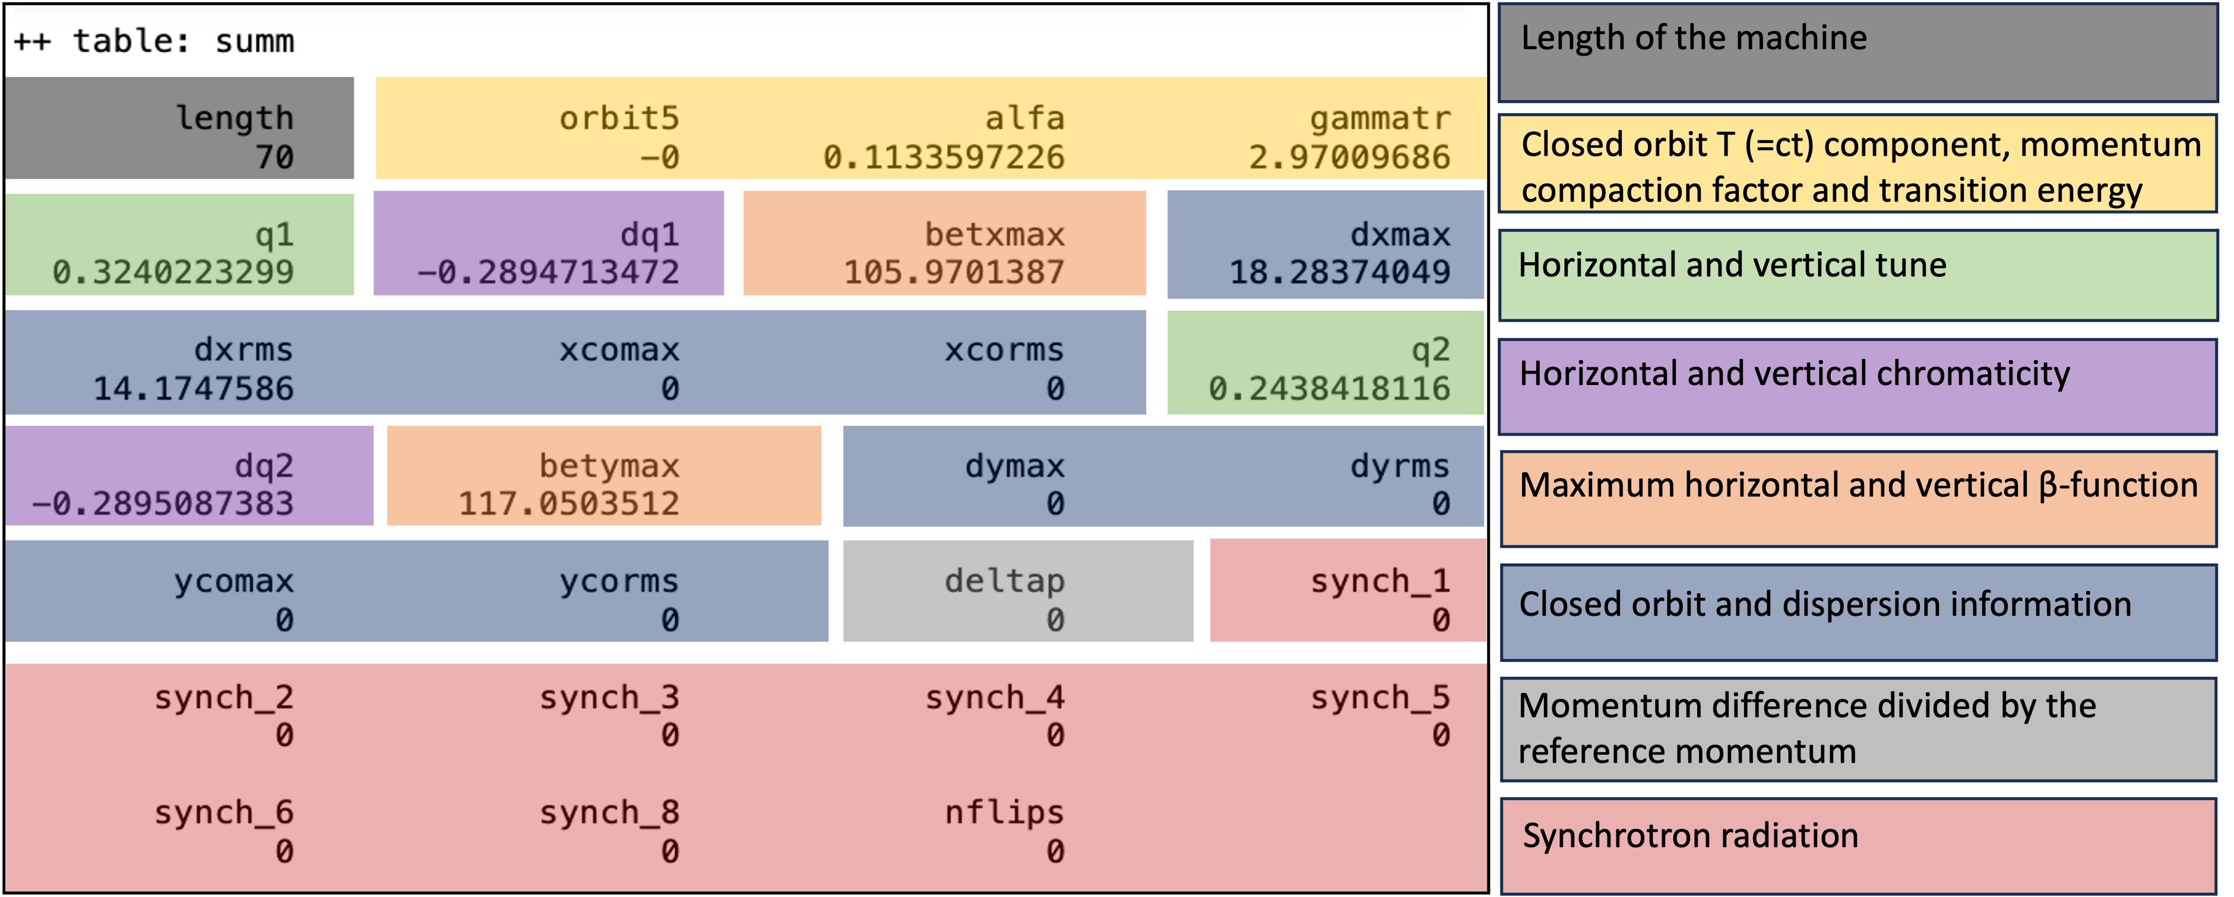
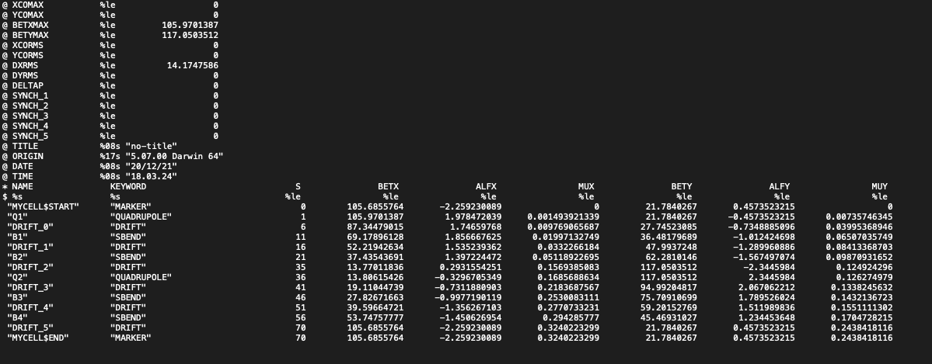
TWISS output
After a successful TWISS run, MAD-X creates a table two tables: ‘SUMM’ and ‘TWISS’, and ASCII file if requested with most of the computed parameters
SUMM table
a=table(SUMM,dq1);
TWISS table
a=table(TWISS,q1,betx);
Location, linear optics functions, closed orbit, magnets properties, first and second order matrix elements… up to 256 columns
ASCII file
SELECT, flag=TWISS, column=name, keyword, s, betx, alfx, mux, bety, alfy, muy;

Slide 27
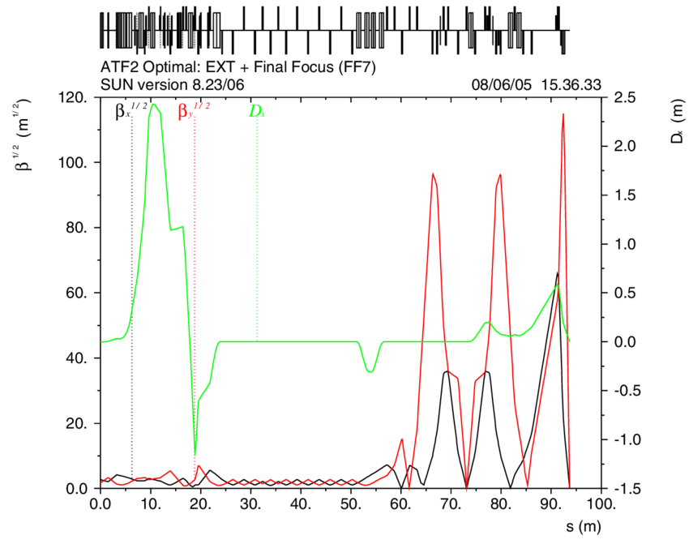
TWISS plot
Production of graphical output of the main optical functions (e.g. β-function):
PLOT, HAXIS=s, VAXIS=betx,bety, COLOUR=100, FILE=“test” ;
FODO cell example
Transfer line example

Slide 28
Global matching
The MATCHING module can be used to design and optimize accelerator lattices
Adjusting the magnetic strengths to get the desired global properties (independent on s-coordinate)
Examples for global parameters: Q1 and Q2 (horizontal and vertical tunes) and dQ1 and dQ2 (horizontal and vertical chromaticity)
Example:
MATCH, SEQUENCE=sequence_name;
GLOBAL, Q1=26.58; H-tune
GLOBAL, Q2=26.62; V-tune
VARY, NAME=kqf, STEP=0.00001;
VARY, NAME=kqd, STEP=0.00001;
LMDIF, CALLS=50, TOLERANCE=1e-6;
ENDMATCH;
Methods for the minimization
LMDIF accepts two attributes:
CALLS, maximum number of calls to the penalty function;
TOLERANCES, the desired tolerance for the minimum.
http://mad.web.cern.ch/mad/releases/5.02.08/madxuguide.pdf
What we want!
What we change!
Method to be used!

Slide 29
Other types of matching
Local matching and performance matching:
Local optical functions (insertions, local optics changes)
Any user defined variable at a given location
Instead of GLOBAL command we use CONSTRAINT!
Example:
MATCH, SEQUENCE=sequence_name;
CONSTRAIN, range=#s/#e, BETX=50;
CONSTRAIN, range=#s/#e, ALFX=-2;
VARY, NAME=kqf, STEP=0.00001;
VARY, NAME=kqd, STEP=0.00001;
LMDIF, CALLS=50, TOLERANCE=1e-6;
ENDMATCH;
What we want!
What we change!
Method to be used!

Slide 30
Tracking
The TRACK module allows us to perform single particle tracking for given initial conditions
It is based on building transfer maps by solving the Hamiltonian equations of each element
Example:
SELECT, FLAG=makethin, SLICE=1;
MAKETHIN, SEQUENCE=seq_name;
TRACK, dump, file=“name”, DELTAP=0.01;
START, x=1e-3, px=0, y=1e-3, py=0;
START, x=1e-2, px=0, y=1e-2, py=0;
run, turns=100;
Convert the thick lattice to a thin lens one!
Off-momentum!
Particles initial conditions!
Number of turns!
Output: ‘TRACK’ table, file.txt
Plot:
PLOT, file="track1",table=track, haxis=x, vaxis=px, colour=100;

Slide 31
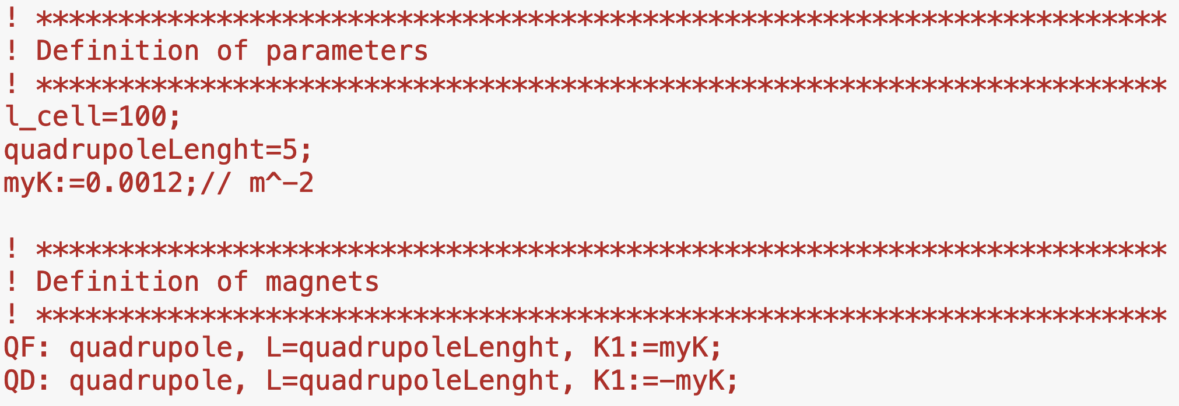
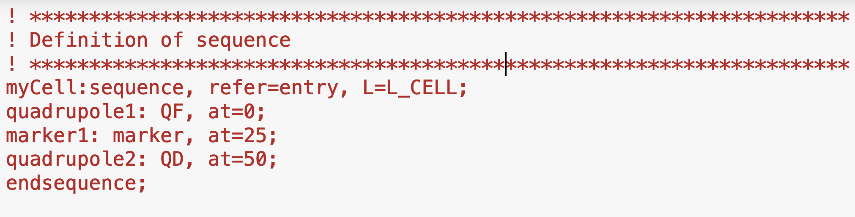
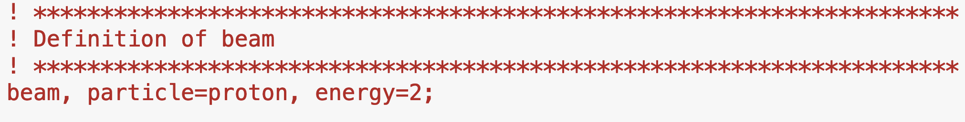
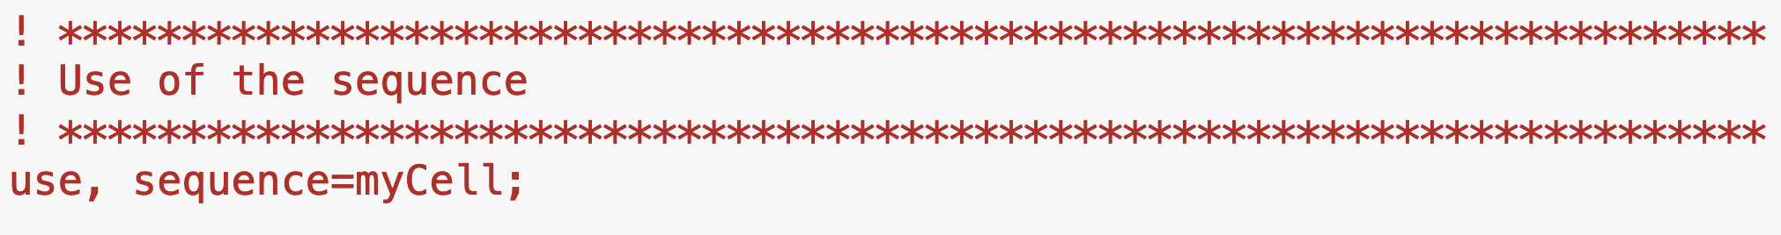
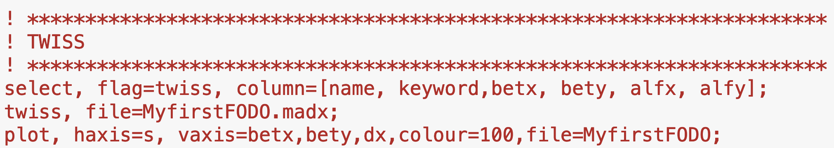
Example case
What is the machine in question?
L_{d}
L_{q}
FQ
DQ
L_{cell}
What will be running in the machine?
What do you want to study about the machine?
Notes:
With the ingredients we have defined so far we can write a basic input file for optics calculations with MAD-X.

Slide 32
How to run MAD-X
Interactive mode
Batch mode
Python interface

Slide 33
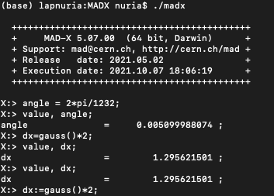
How to run MAD-X: interactive mode
First you need to download the last release from the MAD-X repository and install it following the instructions in: http://madx.web.cern.ch/madx/
In Windows, run the executable
In Linux (OXS), execute ./madx in the containing directory
Then, you can start typing the MAD-X commands one after the other from the command line.
This is usually not practical…

Slide 34
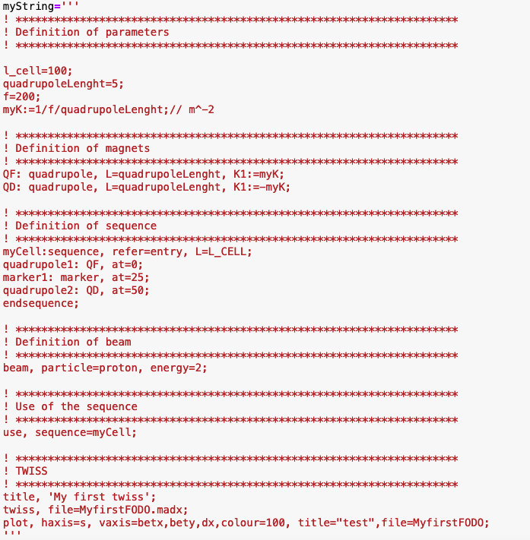
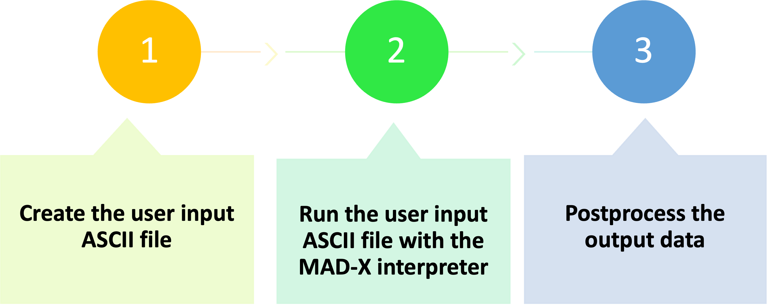
How to run MAD-X: batch mode
After writing your script in a separate file myfile.madx, you can call it in Windows after running MAD-X:
X: ==> call, file=myfile.madx;
In Linux, you can also type in the terminal:
./madx myfile.madx
myfile.madx

Slide 35


How to run MAD-X: python interface I
During the workshop we will use MAD-X trough a python jupyter interface based on the python scripting language
Why?
MAD-X has no graphical interface and for detailed processing of MAD-X results, other programming languages are often used
Python is widely used in the physics community and provides powerful numerical and plotting libraries
Jupyter is web application that allows to create and share live code

Slide 36
How to run MAD-X: python interface II
Load
Run
Jupyter notebook
Cpymad library*
MAD-X process
Communicate with the MAD-X process running in the background using cpymad functions (send MAD-X commands and read output data)
*It is a binding to MAD-X for giving full control and access to a MAD-X interpreter in python http://hibtc.github.io/cpymad/getting-started

Slide 37
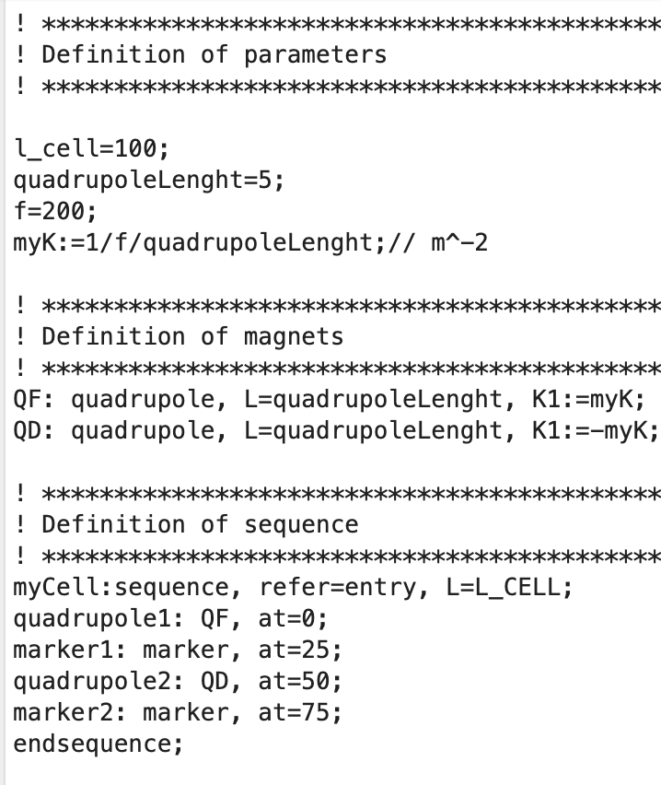
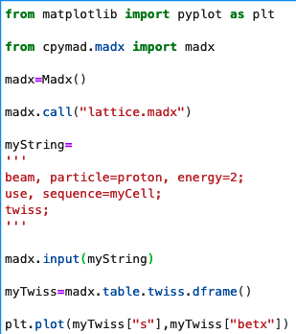
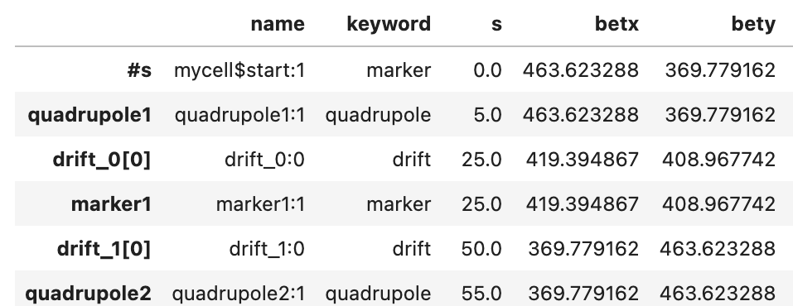
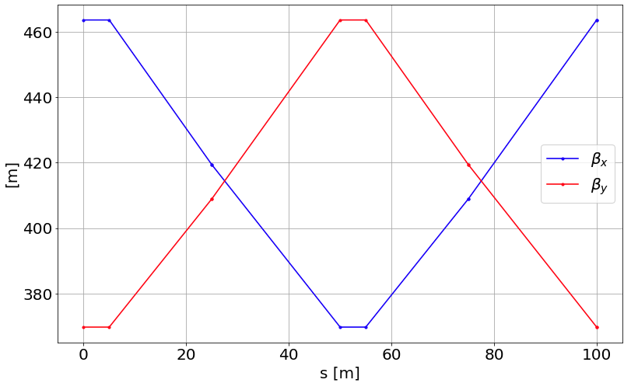
How to run MAD-X: python interface III
Load cpymad library*
jupyter-notebook
lattice.madx
(ASCII file)
Run a MAD-X process
Define lattice input file
Use of cpymad call function
MAD-X commands
Use of cpymad input function
Use cpymad table.name.dframe() function
Data analysis (plots…)

Slide 38
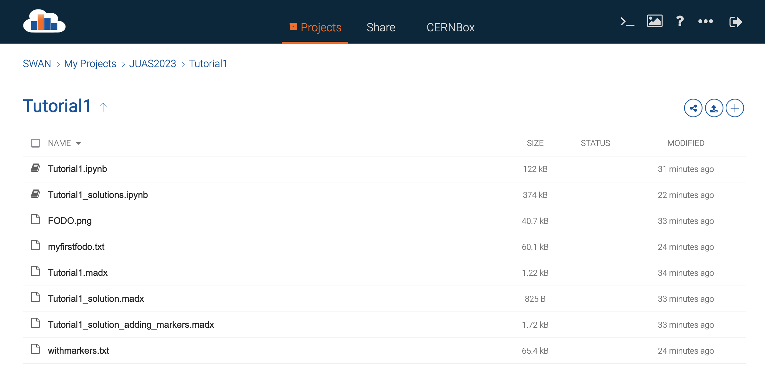
How to run MAD-X: python interface IV
We provided you with the instructions to set-up the working environment: https://fusterma.github.io/JUAS2024/
If you had problems with the environment set-up you can work using the SWAN CERN service using the CERN computing account
SWAN CERN service:
https://swan.cern.ch
Log-in with your credentials
Create a new project, “JUAS 2024”
Load the folders and files in the “MAD-X Workshop JUAS2024 repository” into the new project.
Open the first tutorial jupyter-notebook “Tutorial1.ipynb”

Slide 39
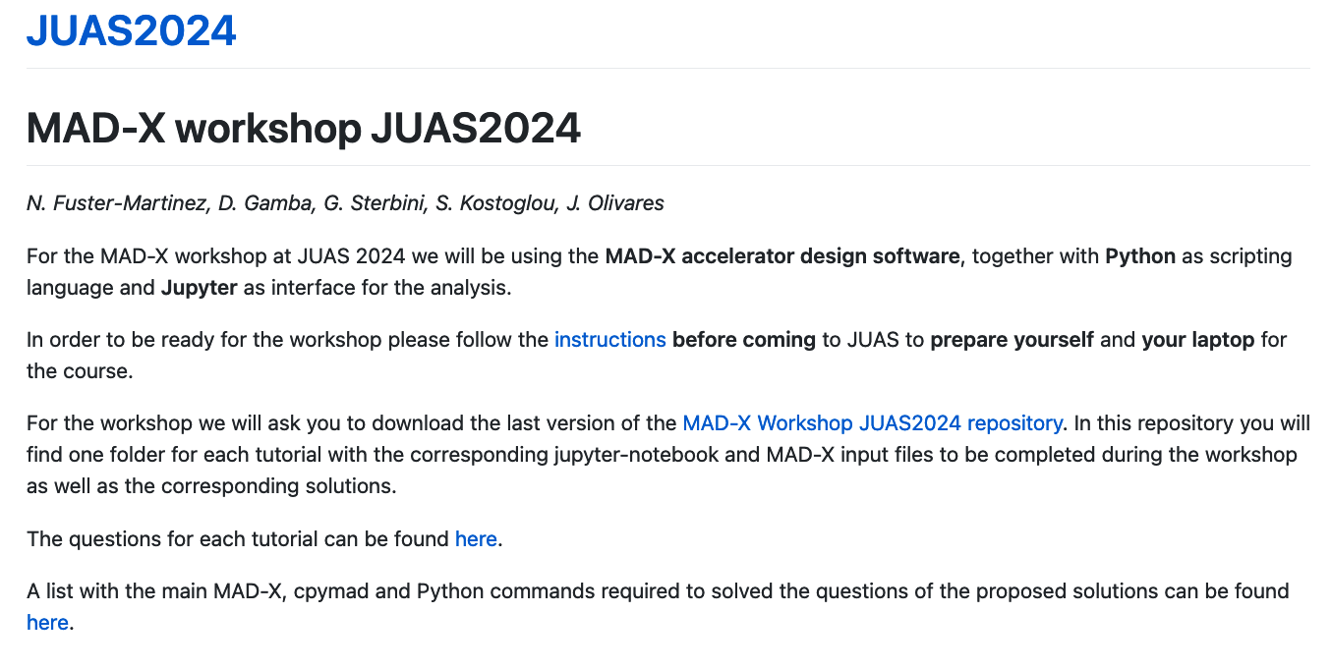
How to run MAD-X: python interface V
https://fusterma.github.io/JUAS2024/
For this afternoon download the last version of the “MAD-X Workshop JUAS2024 repository” and open a JupyterLab to start working on the tutorials!

Slide 40

Thank you very much for your attention!
Questions?
Let’s finish with a quick quiz!

